Slide 1

Lesson 5- Floating and Positioning

Slide 2
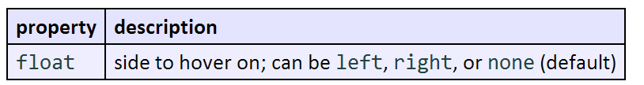
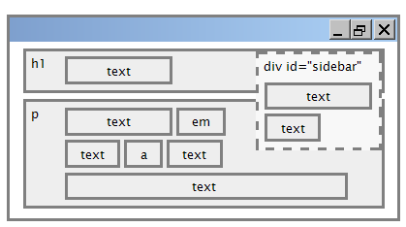
The CSS float property
a floating element is removed from normal document flow
underlying text wraps around it as necessary

Slide 3
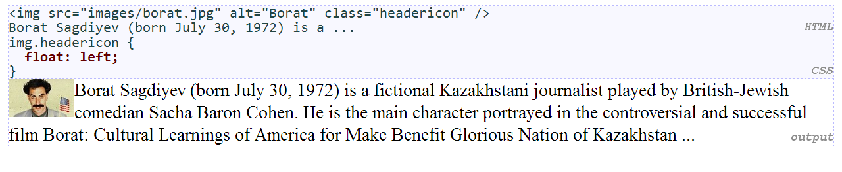
Float example

Slide 4
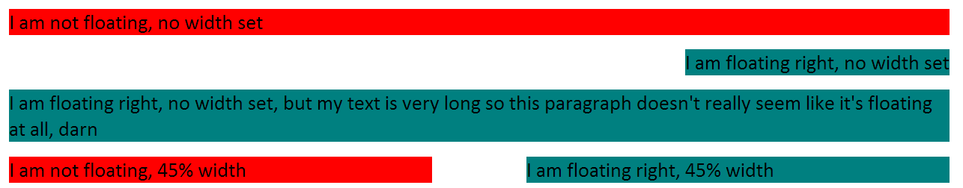
Floating content and width
often floating elements should have a width property value
if no width is specified, other content may be unable to wrap around the floating element

Slide 5
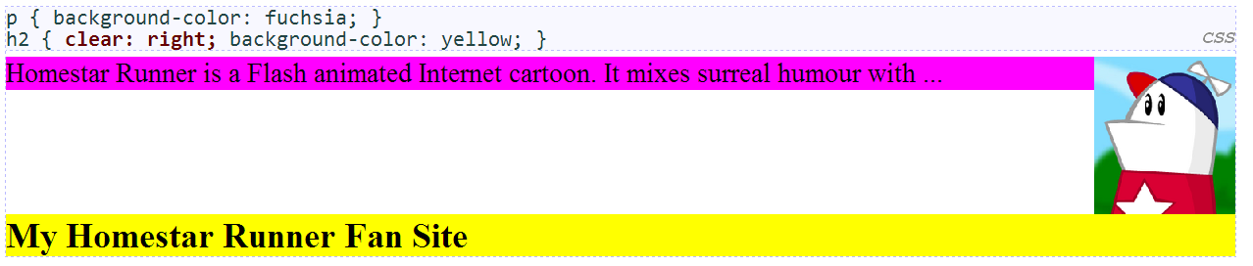
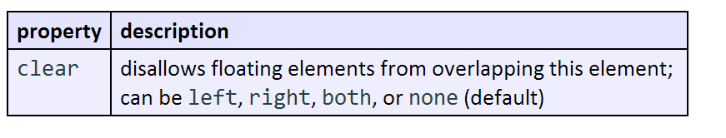
The clear property

Slide 6
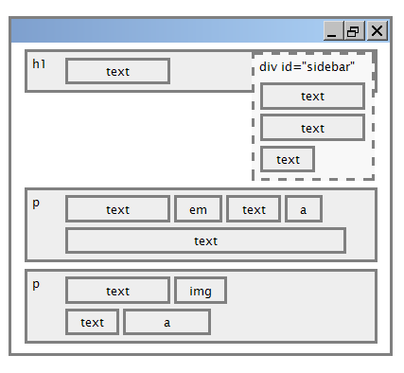
Clear diagram

Slide 7
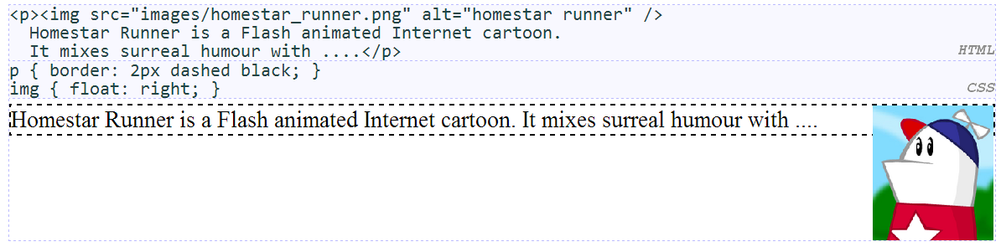
Common error: container too short
We want the p containing the image to extend downward so that its border encloses the entire image

Slide 8
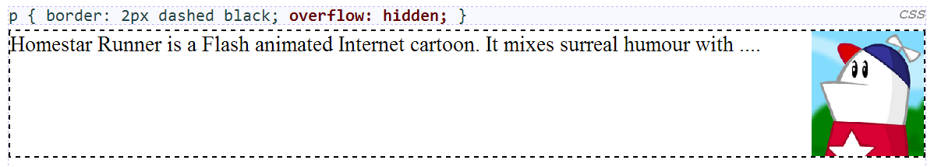
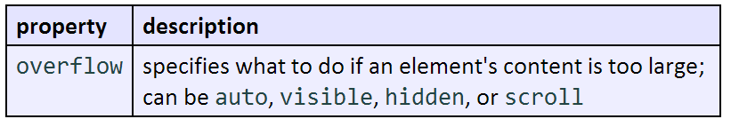
The overflow property

Slide 9
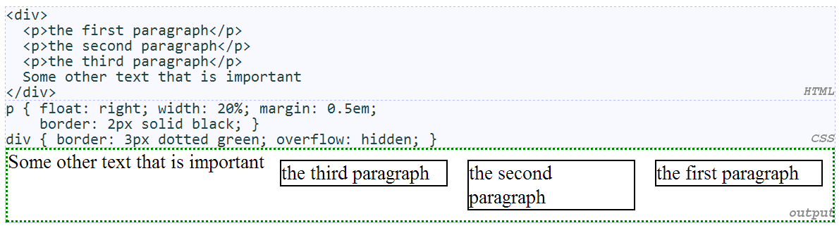
Multi-column layouts

Slide 10
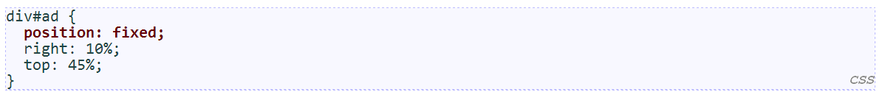
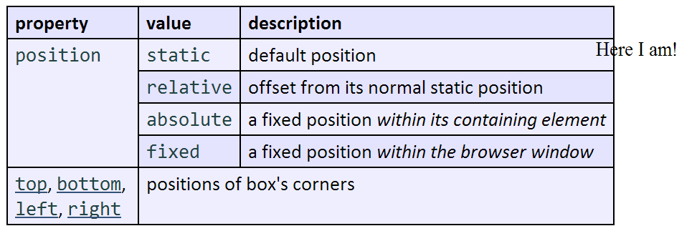
The position property (examples)

Slide 11
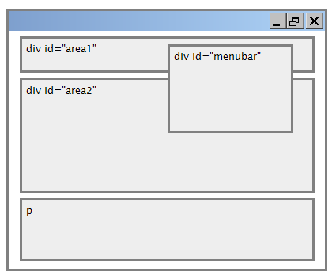
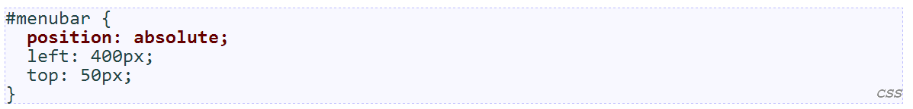
Absolute positioning
removed from normal flow (like floating ones)
positioned relative to the block element containing them (assuming that block also uses absolute or relative positioning)
actual position determined by top, bottom, left, right values
should often specify a width property as well

Slide 12
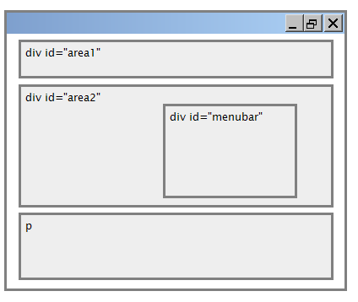
Relative positioning
absolute-positioned elements are normally positioned at an offset from the corner of the overall web page
to instead cause the absolute element to position itself relative to some other element's corner, wrap the absolute element in an element whose position is relative

Slide 13
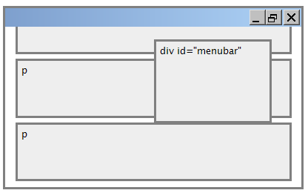
Fixed positioning
removed from normal flow (like floating ones)
positioned relative to the browser window
even when the user scrolls the window, element will remain in the same place

Slide 14
Alignement vs. float vs. position
if possible, lay out an element by aligning its content
horizontal alignment: text-align
set this on a block element; it aligns the content within it (not the block element itself)
vertical alignment: vertical-align
set this on an inline element, and it aligns it vertically within its containing element
if alignment won't work, try floating the element
if floating won't work, try positioning the element
absolute/fixed positioning are a last resort and should not be overused

Slide 15
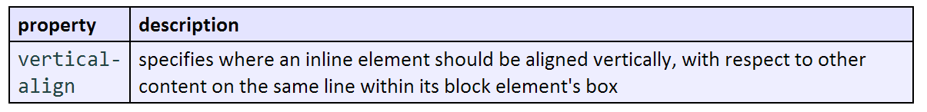
The vertical-align property
can be top, middle, bottom, baseline (default), sub, super, text-top, text-bottom, or a length value or %baseline means aligned with bottom of non-hanging letters

Slide 16
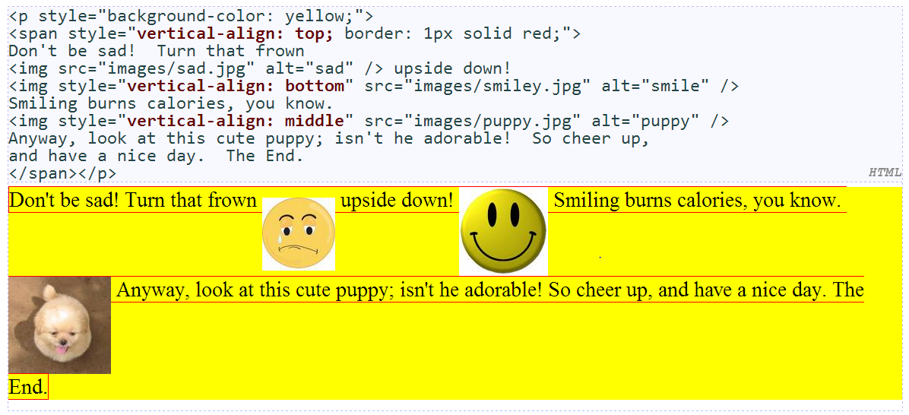
vertical-align example

Slide 17
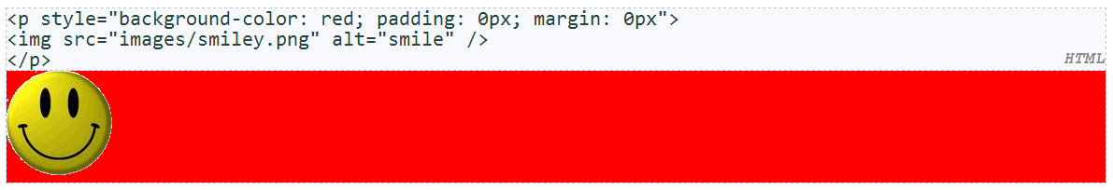
Common bug: space under image
red space under the image, despite padding and margin of 0
this is because the image is vertically aligned to the baseline of the paragraph (not the same as the bottom)
setting vertical-align to bottom fixes the problem (so does setting line-height to 0px)

Slide 18
Details about inline boxes
size properties (width, height, min-width, etc.) are ignored for inline boxes
margin-top and margin-bottom are ignored, but margin-left and margin-right are not
the containing block box's text-align property controls horizontal position of inline boxes within it
text-align does not align block boxes within the page
each inline box's vertical-align property aligns it vertically within its block box

Slide 19
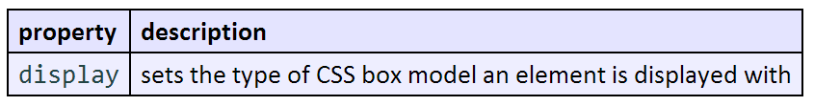
The display property
values: none, inline, block, run-in, compact, ...
use sparingly, because it can radically alter the page layout

Slide 20
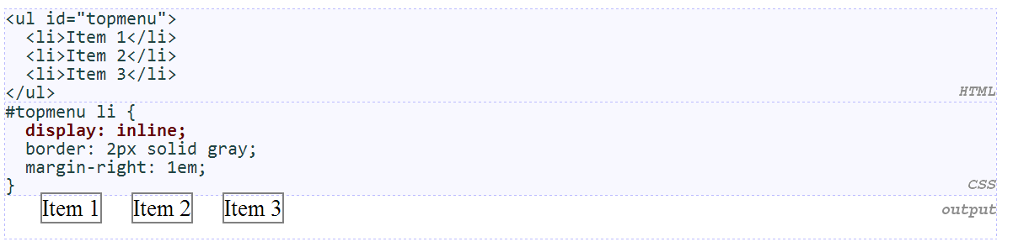
Displaying block elements as inline
lists and other block elements can be displayed inline
flow left-to-right on same line
width is determined by content (block elements are 100% of page width)

Slide 21
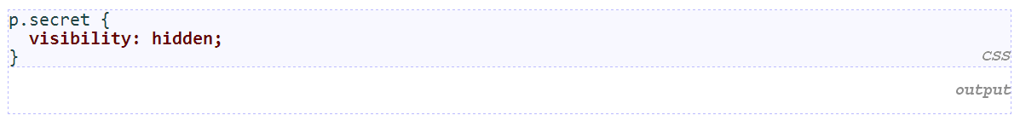
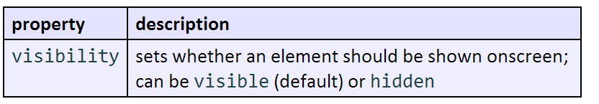
The visibility property
hidden elements will still take up space onscreen, but will not be shown
to make it not take up any space, set display to none instead
can be used to show/hide dynamic HTML content on the page in response to events

Slide 22
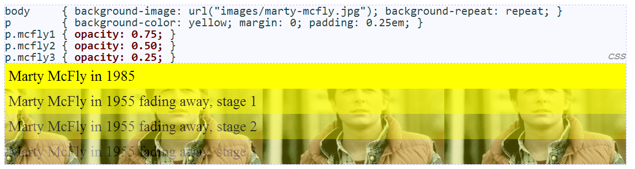
The opacity property

Slide 23
Exercise 1
You are given a file named journal.html and journal_basic.css that represents a page from Victoria's journal. You are to write a stylesheet called journal_layout.css that will transform the layout in different ways throughout the following exercises.
Arrange Your Page into Sections
The first task is to organize journal.html by adding ids, classes, spans and divs. Then, add "boxes" around these sections of the website by adding to your journal_layout.css stylesheet.

Slide 24
Exercise 1 (Cont.)
You are going to match the output below
The borders are all 5px thick and solid.
The colors are the intuitive HTML color names, e.g. the red border is the HTML color red.
Note: You should not need define a class or id specifically for the h2s on this page. Hint: To reduce the amount of id and class attributes you need to set in the XHTML code, consider using CSS context selectors as appropriate.

Slide 25
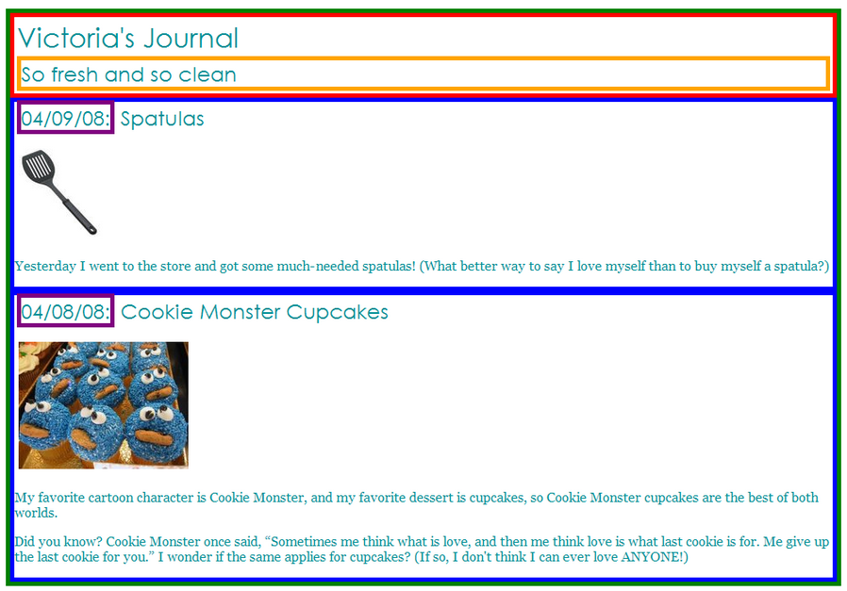

Slide 26

Exercise 1 (Cont.)
Spacing With Padding and Margins, Backgrounds
You are now going to add padding, margins, and backgrounds to some of the parts you defined in question 1. You should only have to change your journal_layout.css file, if you completed Exercise 1 correctly.
The box with the green border should have a background color of white.
The boxes with the blue borders should have a background color of #E8FBFB. It should have a padding of 5px (on all sides) and margin of 10px only on the top of the box (the margins for the remaining sides should be left at 0px).
The overall page content area should become centered on the page, should have left and right margins of 10% and a background image using the following image:

Slide 27
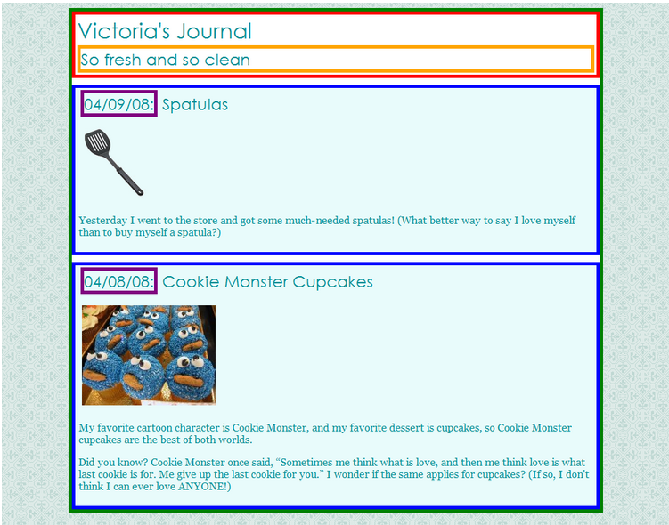

Slide 28
Exercise 1 (Cont.)
Float, Alignment and Clear
You may have to edit your journal.html code as well as your journal_layout.css stylesheet to get the floats working properly.
The heading text in the red box should appear on the right side of that section of the page.
The journal entry images should hover on the right side next to the surrounding text. The image should stay within the bounds of the blue box; that is, it should not bleed into the other content below it.

Slide 29
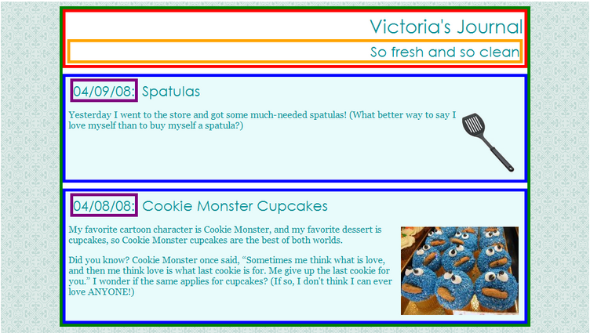

Slide 30
Exercise 1 (Cont.)
Cosmetic Finishing Touches
Finally, we add some finishing touches to make the page look its best.
Change the border of the box with the green border to be a solid, white, 10px-thick border.
Change the border of the boxes with the blue border to have a solid, 4px-thick border, using the hex value #C2E9E9 for its color.
Change the border of the box with the purple border to have only a bottom border, and let that bottom border be blue, dashed, and 2px-thick.
Change the background color of the box with the red border to be #A8F0F0 and get rid of its border altogether.
Change the font size of So fresh and so clean to 14pt and get rid of its border.

Slide 31
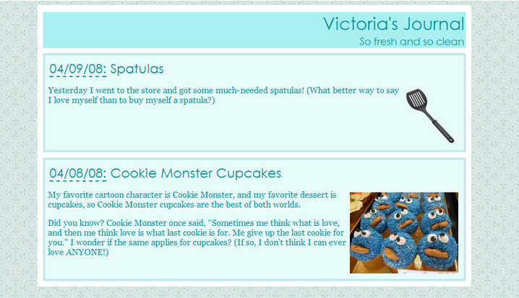

Slide 32
Q & A

